Slide 1
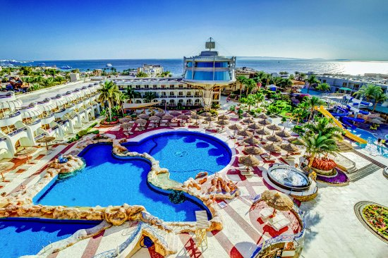
Seagull Beach Resort

Slide 2
Banquet Meeting Kit
Has been created to make it easier for You to do business with Seagull Beach Resort, Hurghada.
We recognized that each of our customers has an individual need when it comes to arranging an event and often with very different budget constraints.
The detailed packages have been designed to offer you the best in meeting facilities and catering, whilst taking into account your budget.
All packages are available. You can then decide on your requirements for catering, assured of a first-class service regardless of your budget.
All of the packages come with our “Meeting Promise” which details our 100 % Guest Satisfaction Guarantee. This means that if you are not satisfied with our service or product and we are not able to make it right, you won’t have to pay.
Below you will find our current rates for Seagull Beach Resort, Hurghada. Obviously, if you have specific requirements, which you do not feel our below-listed packages cover, we will be happy to discuss these with you accordingly.
Meeting special lunch & dinner items and prices to be decided during the deal meeting.

Slide 3
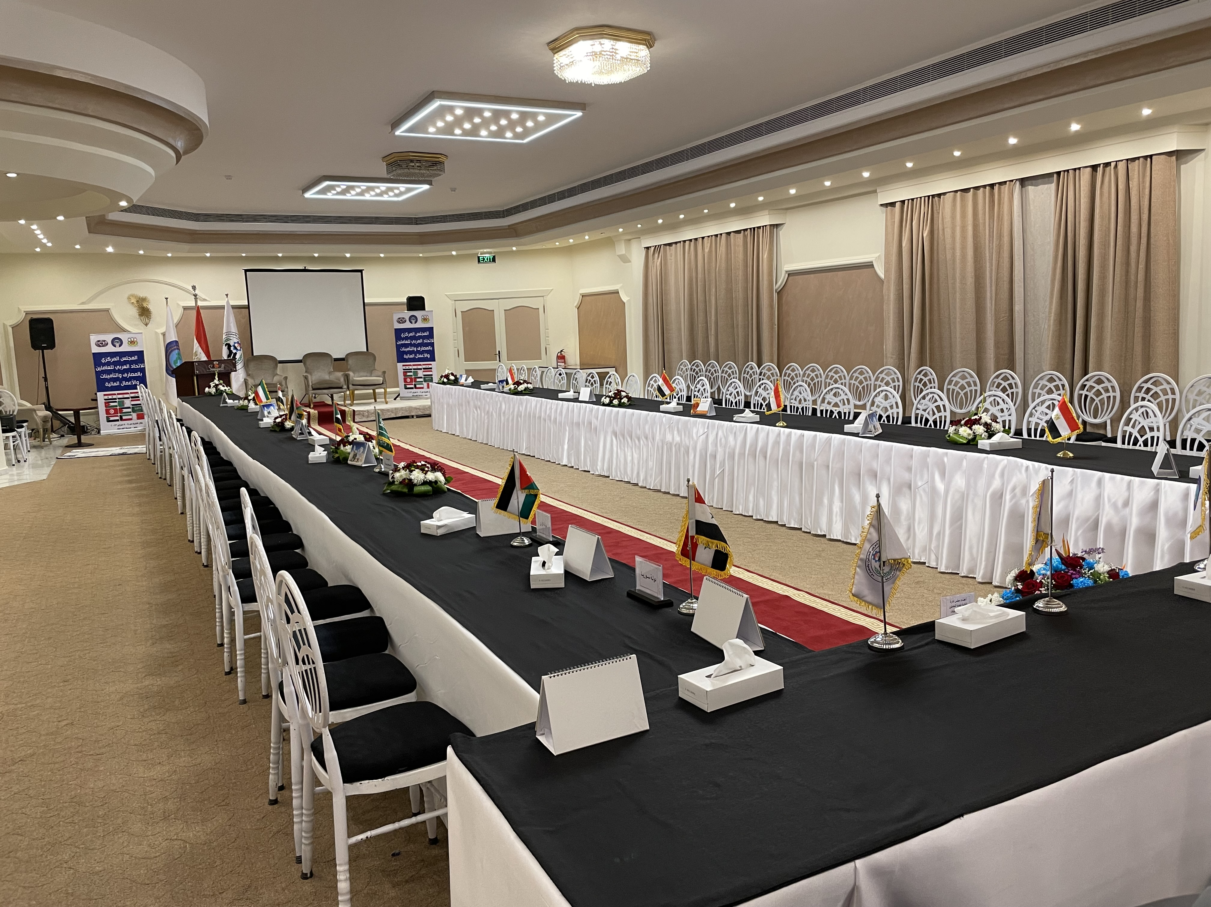
Imagine The Possibilities…
1-Theatre Up To 50 Attendees at conference room 1
2-Theatre Up To 180 Attendees at conference room 2
A Place as Special as Your Meeting Day

Slide 4
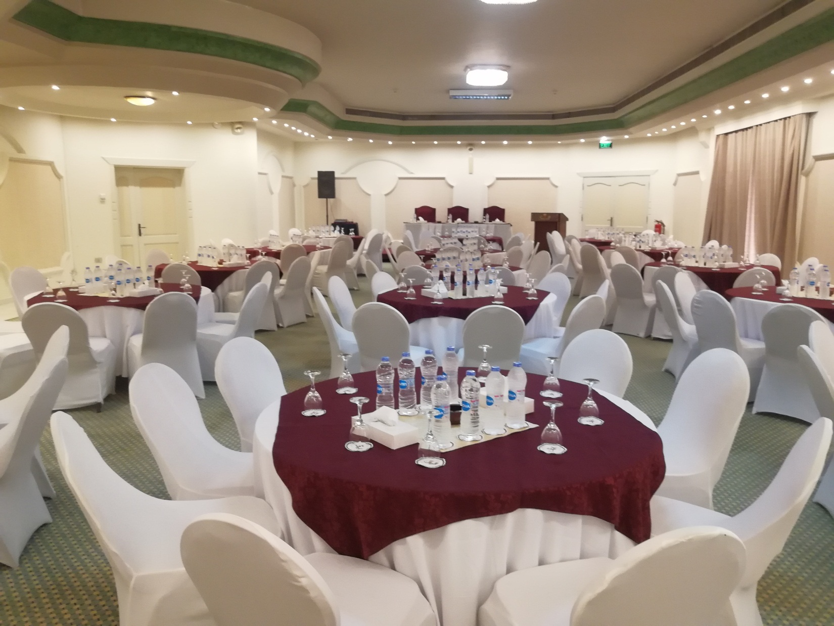
Imagine The Possibilities…
1-Round Table x 8 Up To 120 Attendees at conference room 2
15 Tables Max.
A Place as Special as Your Meeting Day

Slide 5
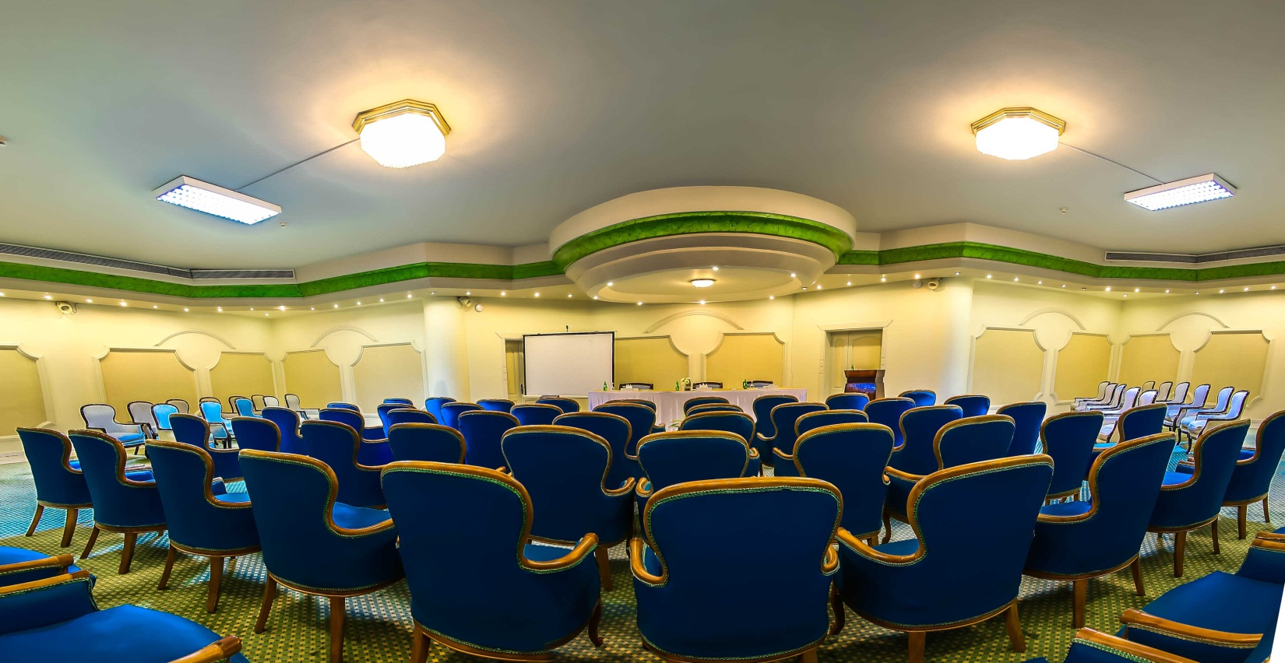
Imagine The Possibilities…
1-Theatre arm chair Up To 20 Attendees at conference room 1
2-Theatre arm chair Up To 100 Attendees at conference room 2
A Place as Special as Your Meeting Day

Slide 6
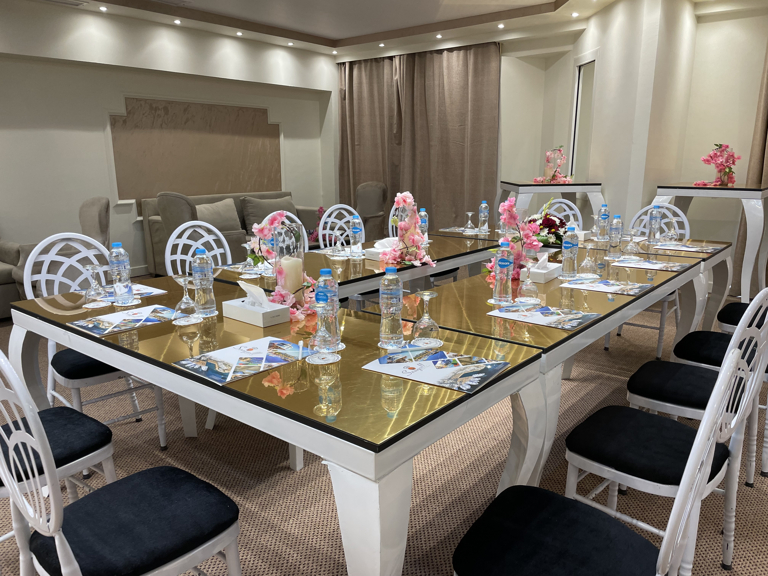
Imagine The Possibilities…
1-U-Shape Up To 18 Attendees at conference room 1
2-U-Shape Up To 40 Attendees at conference room 2
A Place as Special as Your Meeting Day

Slide 7
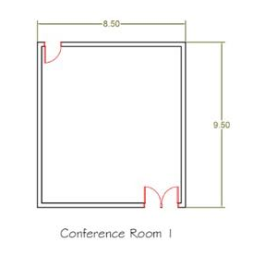
Conference room (1)
Rental Per Day (10000 LE)
Included
Set Up
Note Pads And Pens
Flip Chart
Projector and Screen
Dimensions SQM 80
Styles of Room Set Ups
Theatre Up To 50 Attendees
Class Room Up To 20 Attendees
U-Shape Up To 24 Attendees
Banquet Workshop Up To 32 Attendees
Standing Reception Up To 40 Attendees

Slide 8
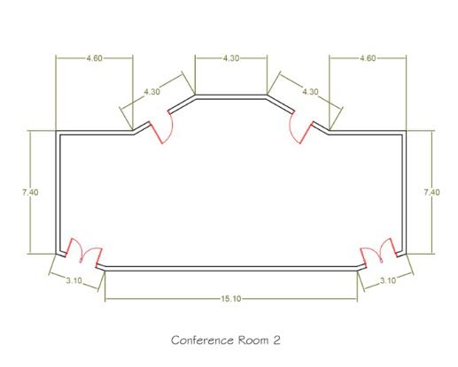
Conference room (2)
Rental Per Day (20000 LE)
Included
Set-Up
Note Pads And Pens
Flip Chart
Projector and Screen
Sound System With Two Microphones
Dimensions SQM 128
Styles of Room Set Ups
1-Theatre Up To 180 Attendees
2-Class Room Up To 60 Attendees
3-U-Shape Up To 40 Attendees
4-Banquet Workshop Up To 80 Attendees
5-Standing Reception Up To 100 Attendees
6- Round Table Up To 120 Attendees

Slide 9
Your Choice of refreshment packages:
1-Refreshment package: Coffee + Tea
2- Refreshment package: Coffee + Tea + Juice
3- Refreshment package:
Coffee + Tea + Juice + s.m.w

Slide 10
4-Refreshment package:
Coffee + Tea +Juice
+ s.m.w + Danish
+ Croissants
5-Refreshment package:
Coffee + Tea +Juice + s.m.w + Danish + Croissants + Cookies
6-Refreshment package:
Coffee + Tea +Juice + s.m.w + Danish +Croissants +
Cookies
English Cake +
Mini Pizza +
Small Open Faced Sandwiches

Slide 11
Optional Extras
We can incorporate the following services into your package. If there is anything else we can assist you with, please do not hesitate to let us know
Entertainment
1. Live Band 2. Belly Dancer
3. Folklore Show 4. Tanoura Show
5. Solo Saxophonist
Price on request
Chair Covers, Table rent, and Flowers
We can supply chair covers with a selection of colored sashes to compliment your color theme as well as flower arrangements to make your setting extra special. These items are at additional cost and we use preferred suppliers of the resort. You are welcome to bring your own items if you wish to supply these personally.

Slide 12
Terms & Conditions
Our goal is to provide event facilities and services of the highest quality.
To assist us in ensuring the success of your function, we would appreciate your attention to the following details.
Tentative Booking/Confirmation
Tentative bookings will be held for a maximum of 14 days, unless otherwise agreed in writing. If the event is not confirmed during this time, the space will be released without notice. All bookings are to be confirmed in writing.
Payment
Full payment is required 1 month prior to the event. Any additional charges are to be paid upon check out.
The following payment plan applies:
Initial confirming deposit- 25% of the total amount of the estimated function value
Second deposit (one month prior to the event)- 50% of the rest of payment
Final payment (2 weeks prior to the event)- the rest 25%

Slide 13
Terms & Conditions
Cancellation
Any cancellation must be advised in writing to take effect.
♥ Events cancelled before 1 month- we will return 50% of the initial confirming deposit.
♥ Events cancelled between 2 to 3 weeks- we will refund 25% of the deposit.
♥ Cancellations made within 1 week- will result is no refund of the deposit.
Prices`
All taxes are included. The prices are current at the time of quotation but may be subject to change at the discretion of the resort management. Upon receipt of your written confirmation and deposit, prices will be confirmed in writing.
Guaranteed Numbers
A guaranteed minimum number of guests attending the event is requested 14 days prior to the event. You will be finally obligated for this number.
Food & Beverage
No food or beverage brought onto the resort premises for consumption during the event without the prior approval of the resort management.
Loss/Damage
Loss or damage to any part of the resort or its equipment will be your financial responsibility. The hotel must approve any hanging of banners/materials prior to the function.

Slide 14
Terms & Conditions
Insurance
Whilst hotel employees will take all care, no responsibility will be taken for damage to, or loss of items, before, during, or after an event and we recommend that you arrange appropriate insurance cover or security. The resort will also not take responsibility for loss or damage to any property belonging to a third-party supplier.
Entertainment
We will be happy to arrange entertainment upon request. All entertainment organized by the guest is subject to approval from the resort.
Photography/Recording of the event
Can be arranged upon request.
Important notes
The organizer must provide the below for meeting or event authorities approval:
Meeting subject.
Attendee list.
Attendee ID/Passport.
The hotel management wishes you a successful event ………..

